Slide 1
Locators In Selenium

Slide 2
Selenium Locators
Selenium Locators are used to identify the web elements in an web page.
Other Names : Page Identifiers, Page Objects
Locating elements in Selenium WebDriver is performed with the help of findElement() and findElements() methods.

Slide 3
findElements()
findElements() returns a list of WebElements matching the search criteria. If no elements are found, it returns an empty list
Syntax: List<WebElement> elementName = driver.findElements(By.LocatorStrategy("LocatorValue"));
EG: List<WebElement> listOfElements =
driver.findElements(By.xpath("//div"));

Slide 4
findElement()
findElement() returns a WebElement object based on a specified search criteria or ends up throwing an exception if it does not find any element matching the search criteria
Syntax: WebElement elementName = driver.findElement(By.LocatorStrategy("LocatorValue"));
EG: WebElement loginLink = driver.findElement(By.linkText("Login"));

Slide 5
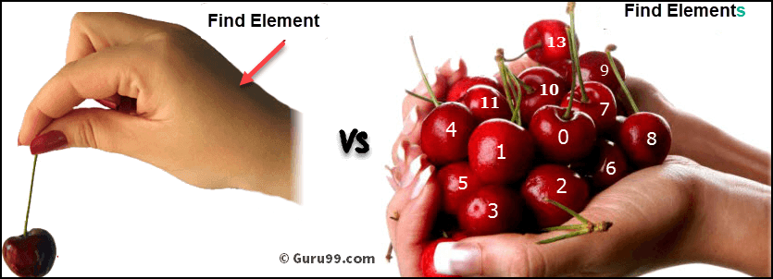

Slide 6
Diff b\w Find Element & Find Elements
Find Element | Find Elements
Returns the first most web element if there are multiple web elements found with the same locator | Returns a list of web elements
Throws exception NoSuchElementException if there are no elements matching the locator strategy | Returns an empty list if there are no web elements matching the locator strategy
Find element by XPath will only find one web element | It will find a collection of elements whose match the locator strategy.
Not Applicable | Each Web element is indexed with a number starting from 0 just like an array

Slide 7
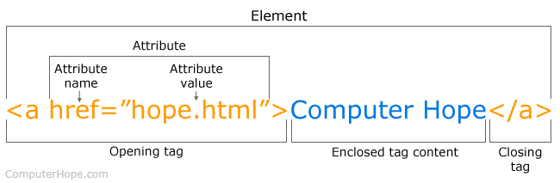
Breakdown of HTML Tag

Slide 8
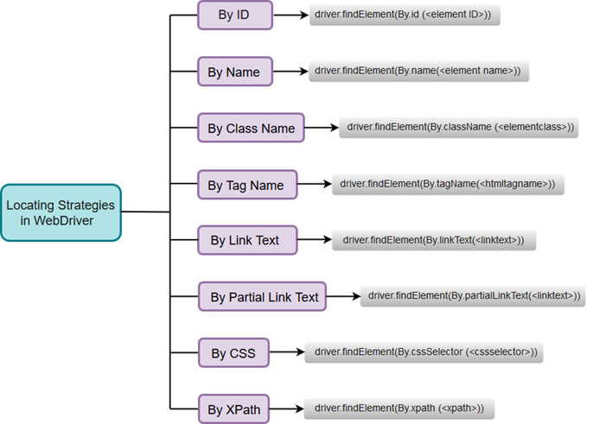

Slide 9
By ID
ID’s are supposed to be unique on a page and it makes ID’s are the most reliable locator
Syntax: driver.findElement(By.id (“attribute value”));
EG: driver.findElement(By.id ("idOfButton"));

Slide 10
By Name
These are not unique on a page. If there are multiple elements with the same Name locator then the first element on the page is selected
Syntax: driver.findElement(By.name (“attribute value”));
EG: driver.findElement(By.name (“firstName"));

Slide 11
By Class Name
Class Name locator gives the element which matches the values specified in the attribute name class
Syntax: driver.findElement(By.className(“attribute value”));
EG: driver.findElement(By.className (“Automation"));
Note : Before choosing class name check whether it is unique or not and Don’t use if the class name contains space

Slide 12
By Tag Name
Tag Name locator is used to find the elements matching the specified Tag Name. It is very helpful when we want to extract the content within a Tag
Syntax: driver.findElement(By.tagName(“attribute value”));
EG: driver.findElement(By.tagName(“button"));

Slide 13
By Link Text
Link Text locator works on hyperlinks
Syntax: driver.findElement(By.linkText(“attribute value”));
EG: driver.findElement(By.linkText(“Forgot Password"));

Slide 14
By Partial Link Text
To find links by a portion of the text in a Link Text element, it contains
Syntax: driver.findElement(By.partialLinkText(“attribute value”));
EG: driver.findElement(By. partialLinkText(“Forgot"));
Note : The text given in the double quotes should be unique inorder locate accurately

Slide 15
By CSS Selectors
Using ID:
Syntax: driver.findElement(By.cssSelector("Tag#Value of id attribute"));
EG: driver.findElement(By.cssSelector(“button#loginbtn"));
Using Class:
Syntax: driver.findElement(By.cssSelector("Tag.Value of class attribute"));
EG: driver.findElement(By.cssSelector(“input.username"));
For More Details Refer : https://www.javatpoint.com/selenium-webdriver-locating-strategies-by-css

Slide 16
Css Selector
Following are some of the mainly used formats of CSS Selectors.
Tag and ID
EG: driver.findElement(By.cssSelector("input#Email"))
Syntax: css=tag#id
Tag and Class
EG: driver.findElement(By.cssSelector("input.text"))
css=tag.class
Tag and Attribute
EG: driver.findElement(By.cssSelector("input[name=Email]"))
Syntax: css=tag[attribute=value]
Tag, Class, and Attribute
EG: driver.findElement(By.cssSelector("input.text[name=email]"))
Syntax: css=tag.class[attribute=value]

Slide 17
Css Selector
Sub-String Matches
Starts With (^)
EG: driver.findElement(By.cssSelector("input[id^=‘una']"))
Syntax: css=input[id^=‘una’]
Ends With ($)
EG: driver.findElement(By.cssSelector("input[id$='name']"))
Syntax: css= input[id$='name’]
Contains (*)
EG: driver.findElement(By.cssSelector("input[id*='id']"))
Syntax: css=input[id*=‘nam']

Slide 18
For Practice
Website link : http://demo.guru99.com/test/newtours/
Scenario :
Hit the above url
Click on register link
Fill the registration form and submit it
Close the browser
Note: leave the dropdown as it

